Slide 1
TITANIC SURVIVA PREDICTION USING MACHINNE LEARING.
By: KRUPALI MISTARI.

Slide 2
Intoduction:
The Titanic was a famous ship that sank in 1912 after hitting an iceberg. About 1,500 people died, and around 700 survived. Many factors, like lack of lifeboats and slow response, contributed to the high death toll.

Slide 3
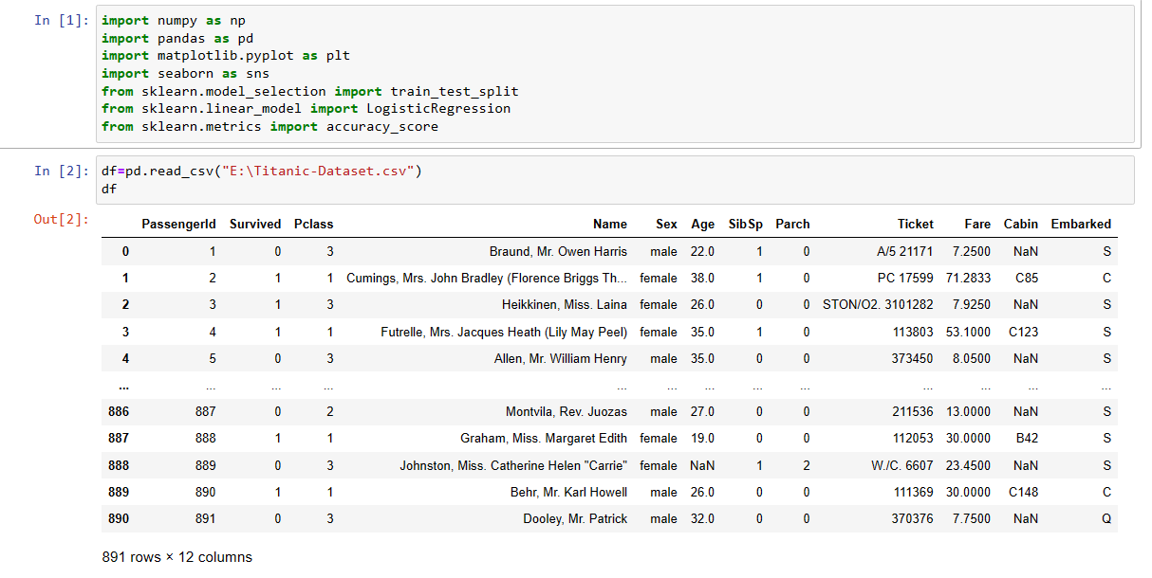
The dataset I’m using here to train a titanic survival prediction model was downloaded from Kaggle. It contains data about all the main features that contribute to the titanic survival. So let’s start this task by importing the necessary Python libraries and the dataset:

Slide 4
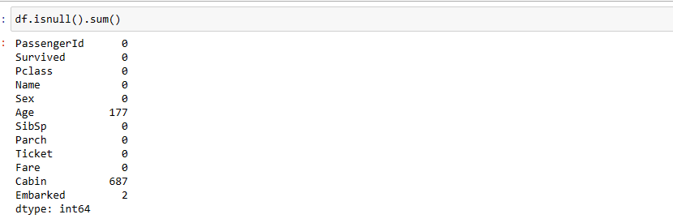
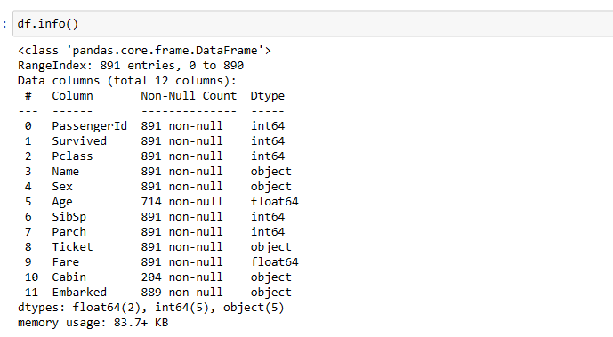
There are 9 columns in this dataset, so it is very important to check whether or not this dataset contains null values before going any further:
So this dataset doesn’t have any null values, now let’s look at some of the other important insights to get an idea of what kind of data we’re dealing with:

Slide 5
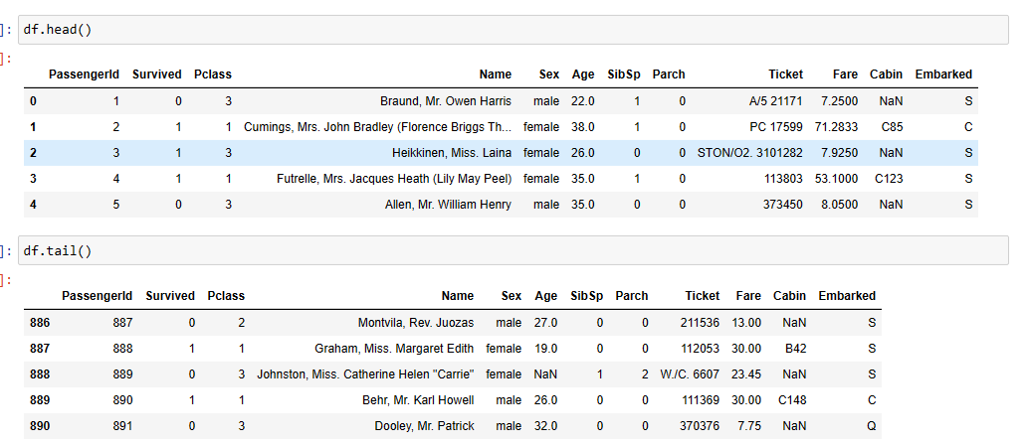
Lets check head and tail of the dataset
With The help of head() function we can able to check our first 5 columns from our dataset
With The help of tail() function we can able to check our last 5 columns from our dataset

Slide 6
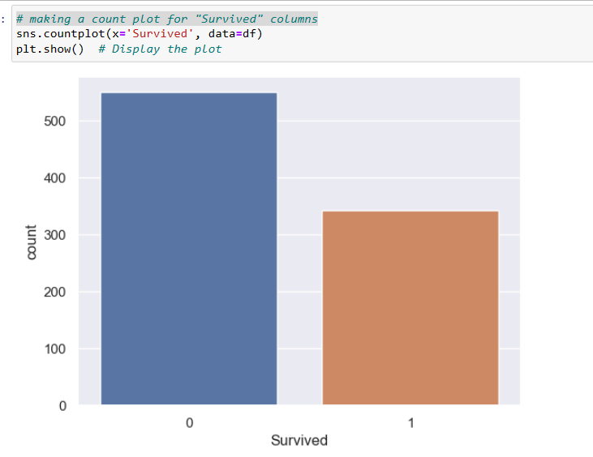
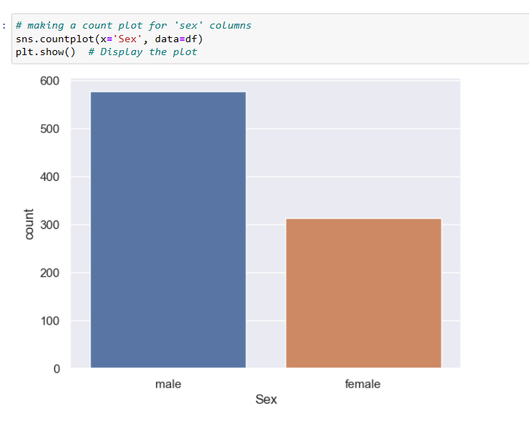
Making a count plot for “Survival ” columns
Making a count plot for “Sex” cloumns

Slide 7
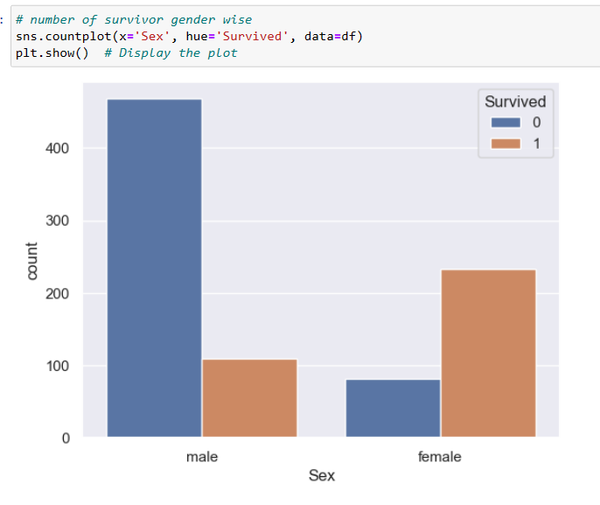
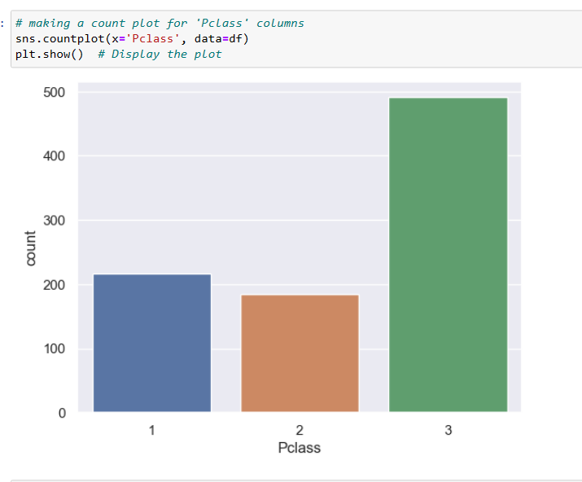
Number of survival gender wise
Making a count plot for “Pclass” columns

Slide 8

With The help of shape we can able to check over all shape of our dataset
I will use Logistic Regression and the Random Forest clasification algorithm to train a Titanic Survival Prediction model. So let’s split the data into training and test sets
Logistic Regression:
Logistic Regression in Machine LearningLogistic regression is a supervised machine learning algorithm mainly used for classification tasks where the goal is to predict the probability that an instance of belonging to a given class or not. It is a kind of statistical algorithm, which analyze the relationship between a set of independent variables and the dependent binary variables.
Random Forest Classification:
Random Forest Classification is a supervised machine learning technique that builds a collection of decision trees during training and combines their outputs to classify data points into different classes or categories. It is known for its high accuracy, robustness against overfitting, and capability to handle complex datasets with various features.

Slide 9
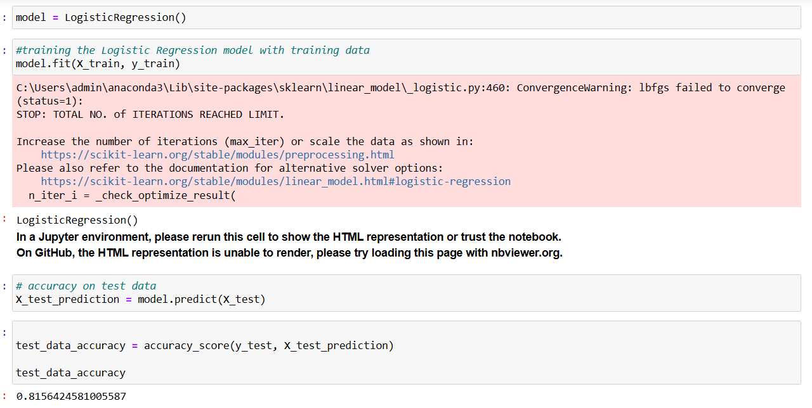

Slide 10
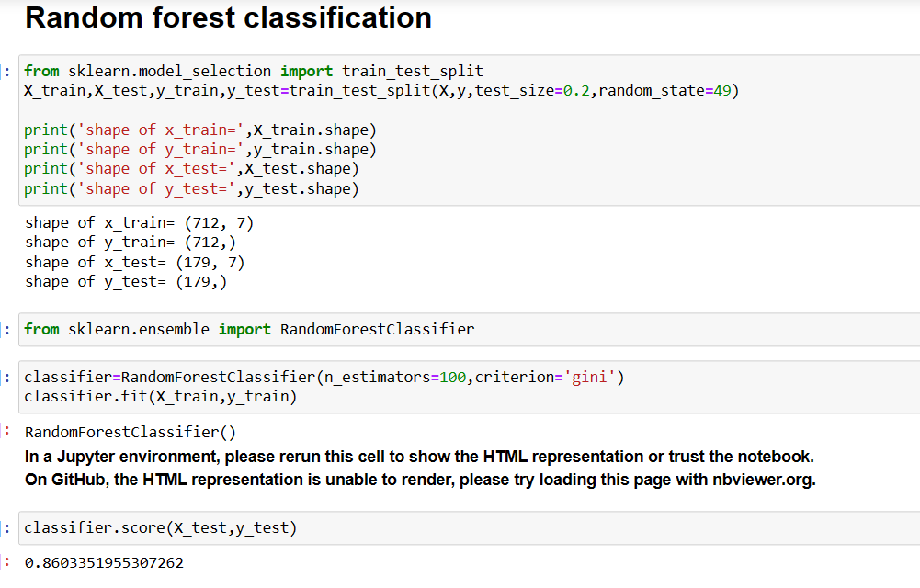

Slide 11
THANK YOU

